Slide 1

ArcGIS Experience Builder: getting your feet wet
Presenters: Chad Nunemacher & Paul Hedlund

Slide 2




ArcGIS Experience Builder technologies
Superset of Javascript used to develop widgets
JS library used for creating user interfaces
Javascript xml – allows you to describe what widget UI should look like via React
Experience Builder’s JS library used to create widgets

Slide 3




JIMU
Experience Builder’s extensibility framework. It’s built upon the following:
ArcGIS JS 4.X API
React + Redux
Bootstrap 4
HTML 5

Slide 4


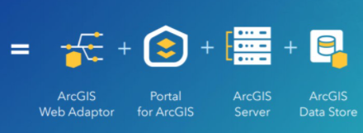
Experience builder platforms and Deployments
ArcGIS Enterprise 10.6 or Later (on-premise – integrated version/GUI version 10.8.1 or greater)
ArcGIS Online (SaaS – integrated version/GUI available)
Developer Edition (customized experience associated with AGO or Enterprise)

Slide 5
Experience Build requirements
Laptop, Desktop, or tablet( for editing)
Any internet connected device (for viewing)
Supported browsers(Google Chrome, Microsoft Edge, Firefox, Safari)
Note: Only WebGL-enabled browsers are supported (this can be tested and verified by going to get.webgl.org)
Must have ArcGIS developer account or be member of AGO organization with create privileges to create experiences. Anyone can view public experiences.
Experience builder supports all languages that ArcGIS Online supports

Slide 6

Comparing Experience Builder and Web AppBuilder
Experience Builder
Map-centric or non-map-centric
Single page or multipage
Mobile-adaptive design
Integrates with both 2D and 3D content
Cross widget interactions and configuration
Have developer edition
very few widgets
Newer product with ongoing enhancements
Web AppBuilder
Map-centric
Single page
Mobile friendly
2D or 3D content but can’t integrate them
Widgets can not interact with other widgets
Have developer edition
70+ widgets
Mature product with few future enhancements

Slide 7
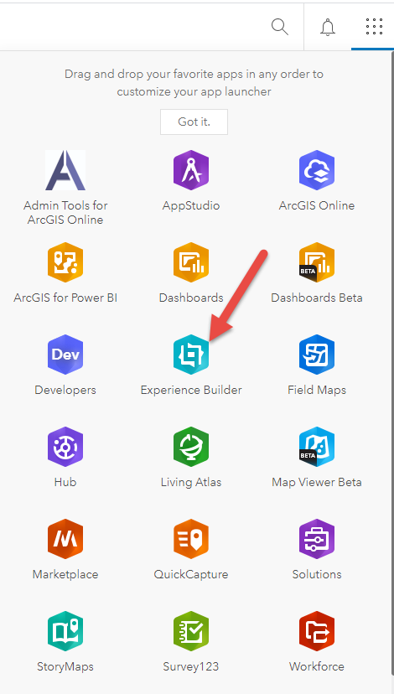
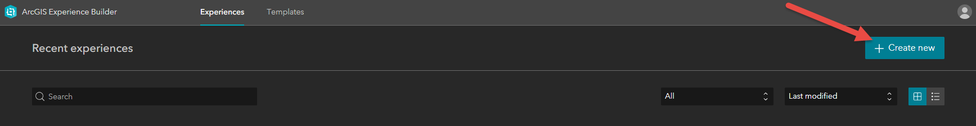
ArcGIS Online Experience Builder
Log into your ArcGIS Online Account (Make sure you have creator privileges)
Navigate to the Experience Builder App in ArcGIS Online and Click on Icon
First time click on “create new” to start an experience project (from your experiences you can create a template to use for future experiences)

Slide 8
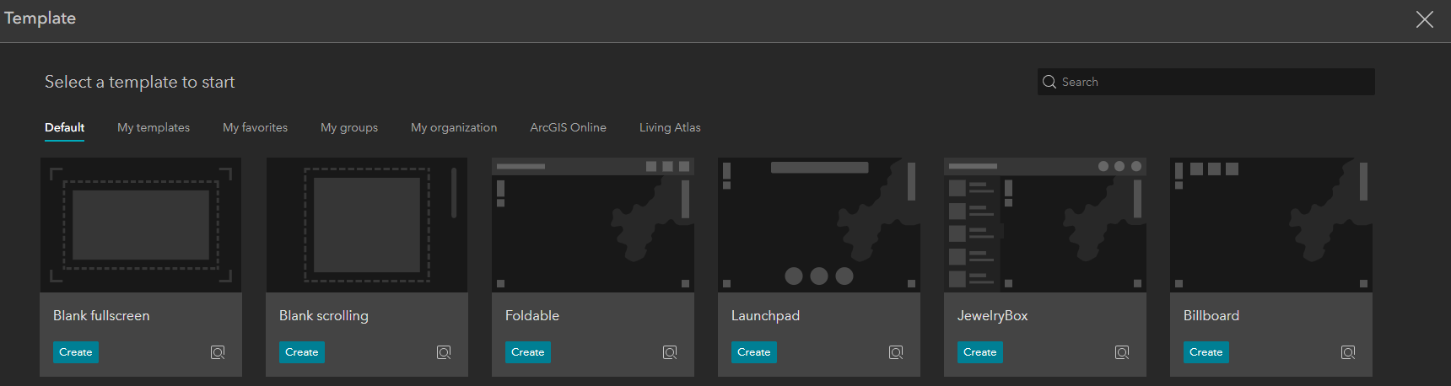
ArcGIS Online Experience Builder
- Then Select a template to start (pick from a default theme or create from a provide template)

Slide 9
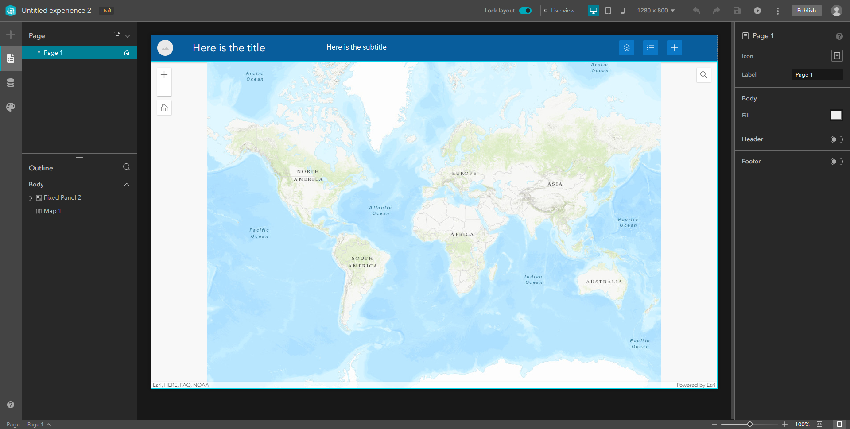
ArcGIS Online Experience Builder (Default Layout View for Foldable Theme)

Slide 10
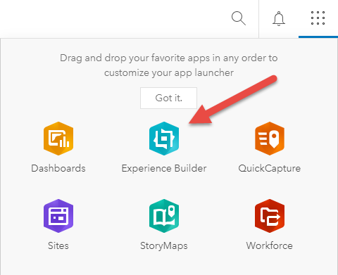
ArcGIS Enterprise Experience Builder
Log into your ArcGIS Enterprise Portal Account (Make sure you have creator privileges)
Navigate to the Experience Builder App in ArcGIS Online and Click on Icon
First time click on “create new” to start an experience project (from your experiences you can create a template to use for future experiences)

Slide 11
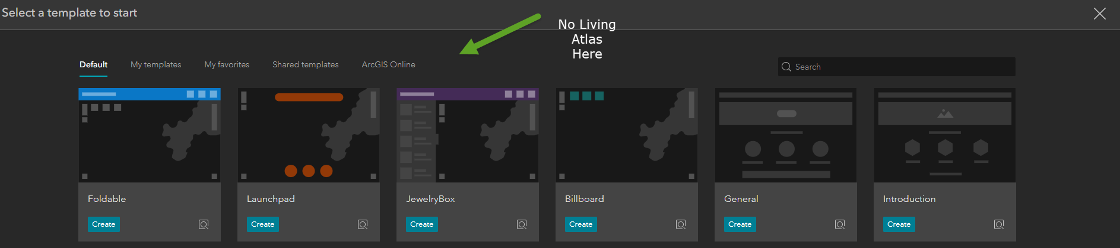
ArcGIS Enterprise Experience Builder
- Then Select a template to start (pick from a default theme or create from a provide template – almost identical to AGO interface except for a couple items

Slide 12
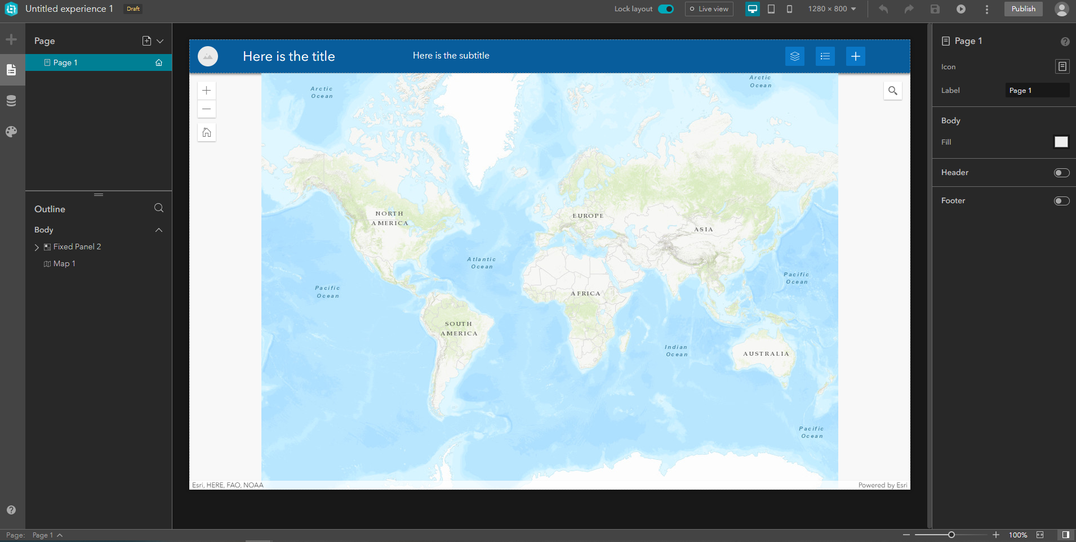
ArcGIS Enterprise Experience Builder (Default Layout View for Foldable Theme)

Slide 13
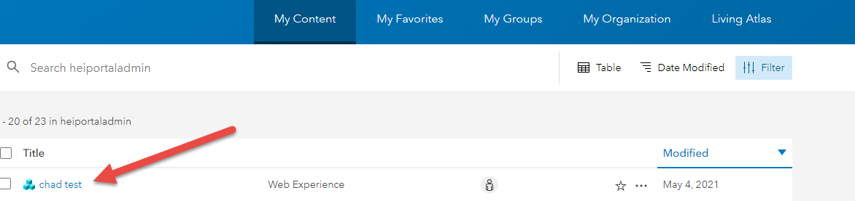
ArcGIS Experience Builder
After you name you app, go to your Portal for ArcGIS or ArcGIS online My Content page. You will see your named Experience Builder app classified as “Web Experience”

Slide 14
ArcGIS Integrated Experience Builder
Let’s Quickly go over the some of Experience Builder interface tools and elements and build a quick integrated app. Most of the feature are self explanatory so I encourage you to explore on your own time

Slide 15
Experience Builder Developer Edition (part 1 – The SETUP)

Slide 16
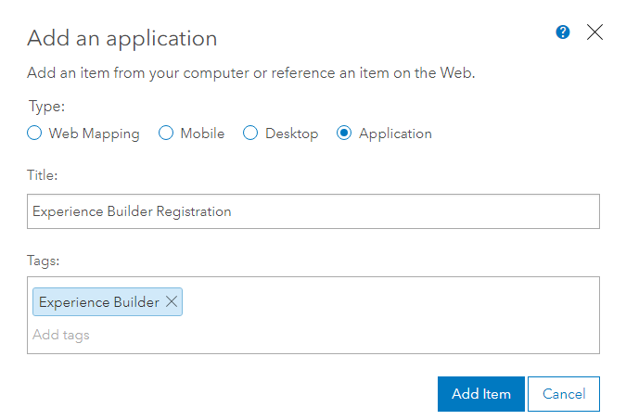
ArcGIS ONLINE Registration for Experience Builder
Registration Info obtained from the following: https://developers.arcgis.com/experience-builder/guide/install-guide/
Log into you ArcGIS Online Account
For our U of M account, was go here: https://umn.maps.arcgis.com
Click Sign In in upper right of home page
Click ArcGIS Login and enter provided credentials by U of M GIS Staff
Then Click on “Content” and then “My Content”
Click “Add Item” and Select “An Application”

Slide 17
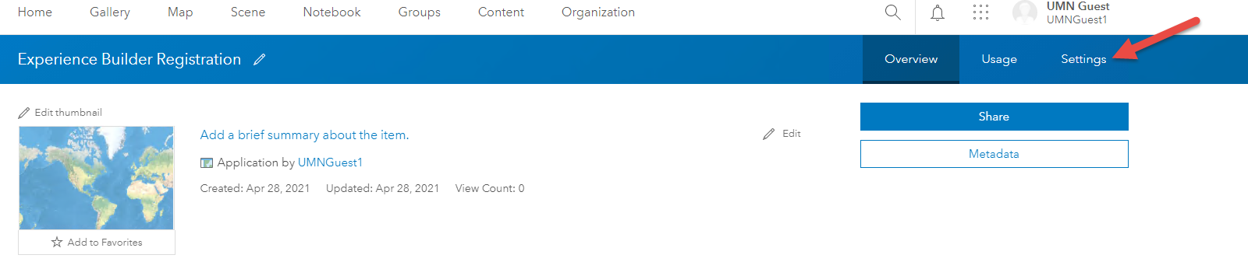
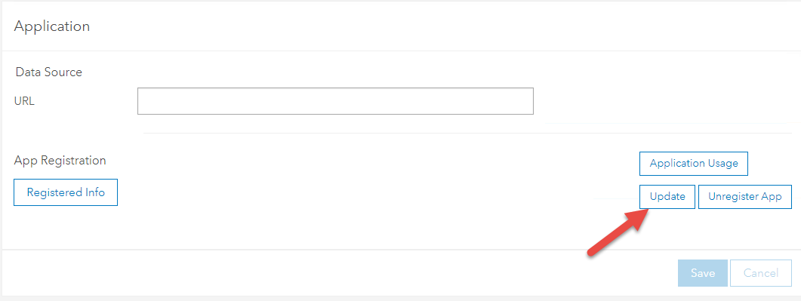
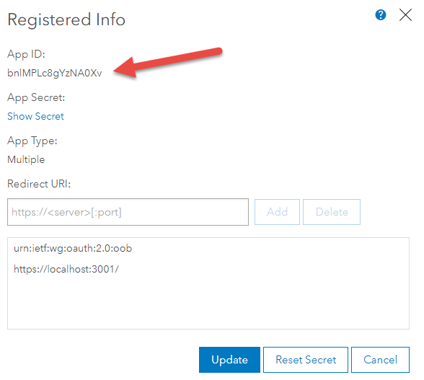
ArcGIS ONLINE Registration for Experience Builder
Click on Settings
Scroll down to Application section and hit “Update”
On “Registered Info” dialog box, enter https://localhost:3001/ and hit “Add” then “Update”
Copy and paste App ID to notepad or notepad++ for this will be needed when connecting the first time to AGOL via Experience Builder

Slide 18
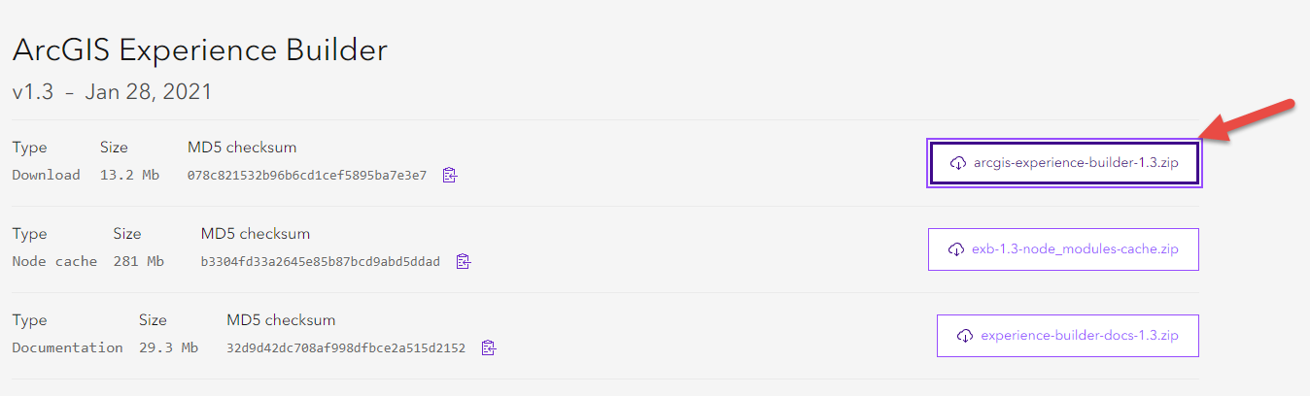
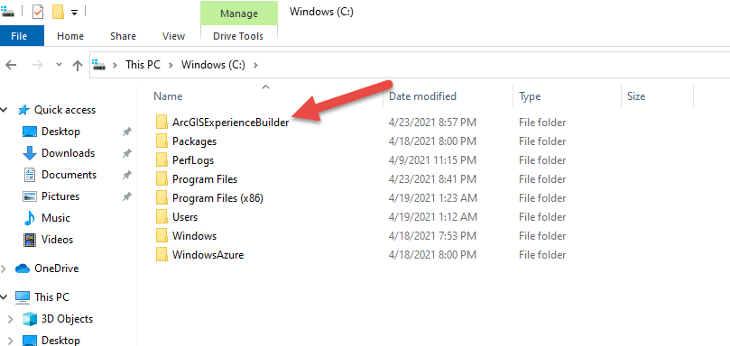
Download, install, and configure Experience Builder
Experience Builder runs on top of Node.js 12+.x, download and install Node.js (https://nodejs.org/en/download/) for your operating system. In our case, we will install LTS 64 bit Windows Installer (.msi). Just use all defaults and quickly install Node.js
Download experience builder from the following: https://developers.arcgis.com/downloads/apis-and-sdks/?product=arcgis-experience-builder
Who will likely be prompted to enter your ArcGIS Online (AGO) account info. Enter AGO username and password provided by U or M GIS Staff
On the downloads screen, scroll down and click on “arcgis-experience-builder-1.3.zip” or newer. Download will then start. Once download complete, unzip (extract) to root of C: drive for this workshop

Slide 19
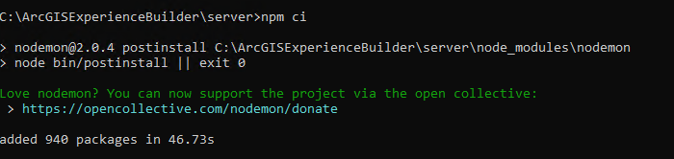
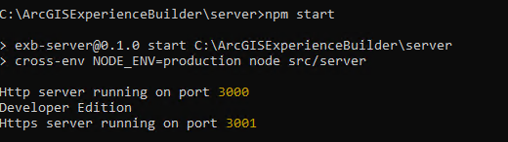
Download, install, and configure Experience Builder
Open Command or terminal window (easy way to open window in just type “cmd” in “type here to search” window and bottom of Windows screen and hit “enter”
Navigate to server directory of Windows installation by typing the following command prompt: cd /arcgisexperiencebuilder/server
Then at the prompt type: npm ci (this will install necessary modules)
Then at the prompt type: npm start (this will start experience builder service)
Open browser (Chrome for this workshop) at enter the following URL to launch EXB https://localhost:3001/

Slide 20
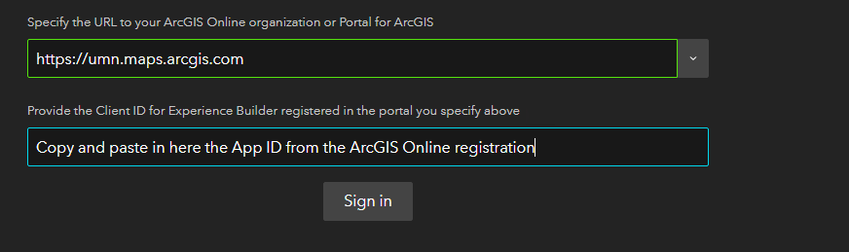
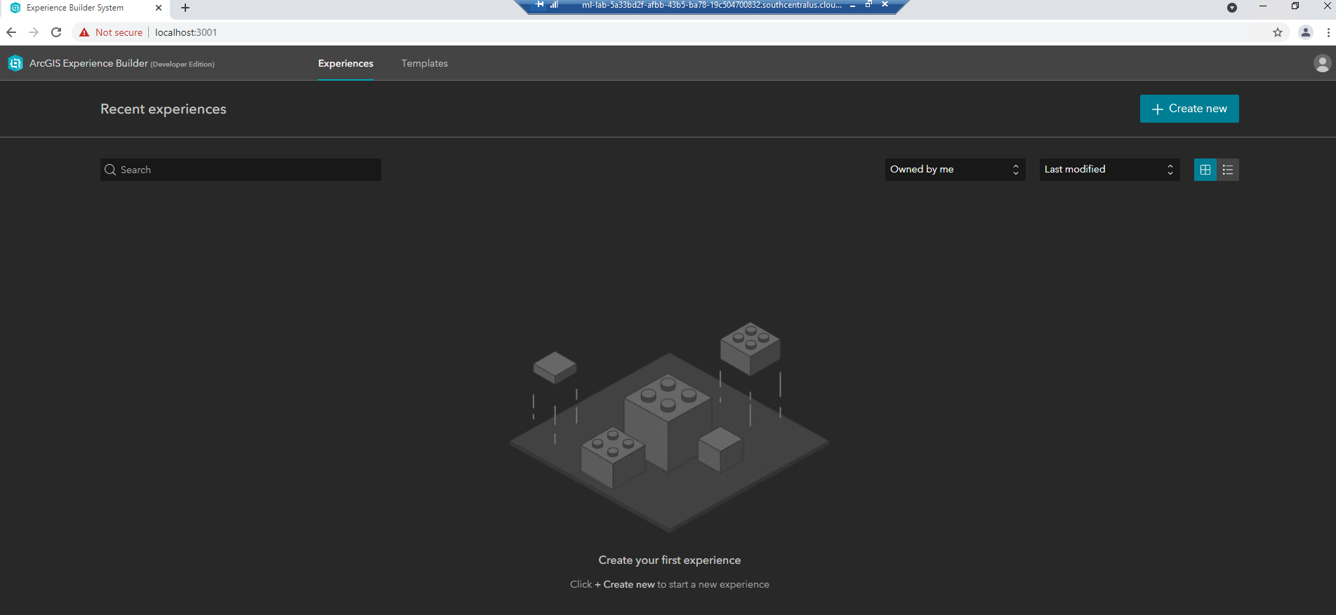
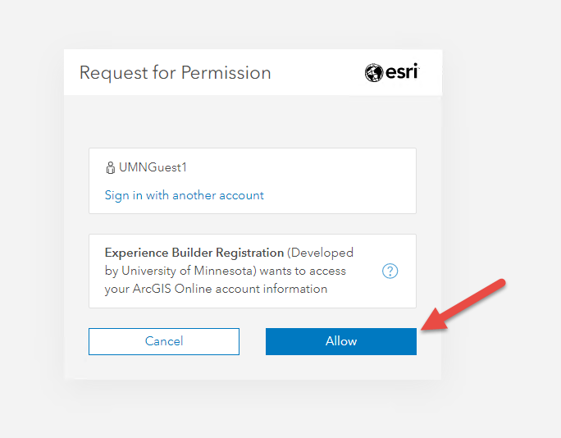
Download, install, and configure Experience Builder
When Experience Builder is launched for the first time you may hit a landing page saying this site is insecure. Just hit advanced and proceed. For this workshop, SSL certs weren’t used so to the left of the URL it will say “Not secure”
Then you will be prompted to enter your ArcGIS Online Account URL (Or portal URL if using enterprise) and also the client ID which is the app ID you copied to notepad or notepad ++ earlier
Enter in this information and allow “request for Permission” and you have successfully configured the server side of the developer edition of Experience Builder

Slide 21
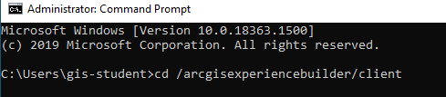
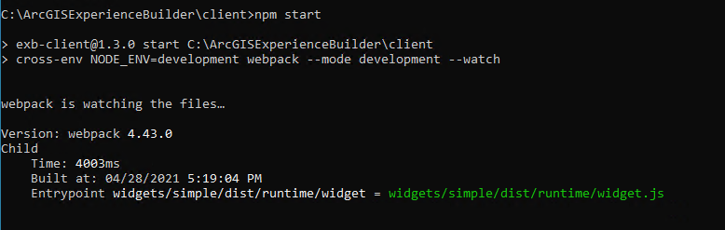
Download, install, and configure Experience Builder
At This point we are done installing and configuring EXB if we just want to use the build in GUI, but if this was the case we could have just used the integrated AGO or ArcGIS 10.8.1+ integrated version of Experience Builder. We want to develop a custom widget so we will also need to do the Client install which will install a service to launch webpack to help with the bundling/loading of custom widgets and themes
Open command prompt again and type the following at command prompt and hit enter: cd /arcgisexperiencebuilder/client
Then type the following at the command prompt and hit enter: npm ci (this will install necessary modules)
Once modules have been installed, type in the following at command prompt: npm start
You can now start developing your custom widget

Slide 22
Paul Takes Over

Slide 23

Now on to that coding stuff

Slide 24

Under the hood
Web AppBuilder
JavaScript API 3.X
Dojo
Experience Builder
JavaScript API 4.X
React

Slide 25
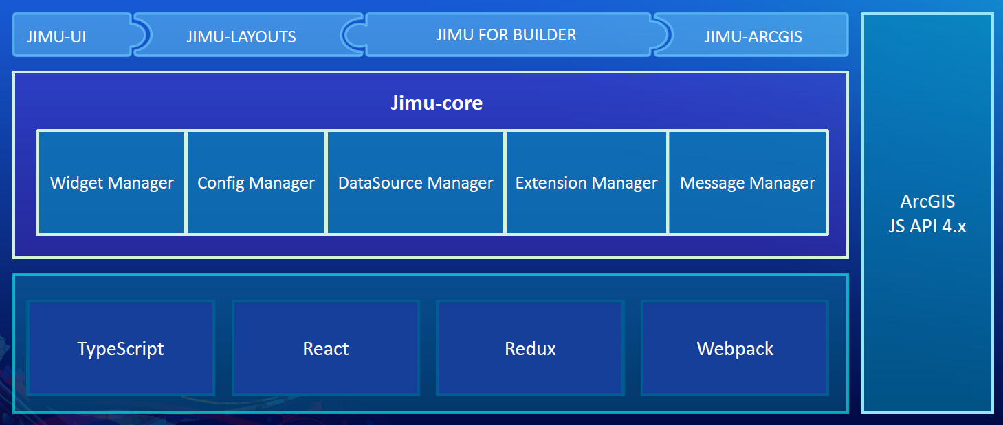
Under the hood – In Detail

Slide 26



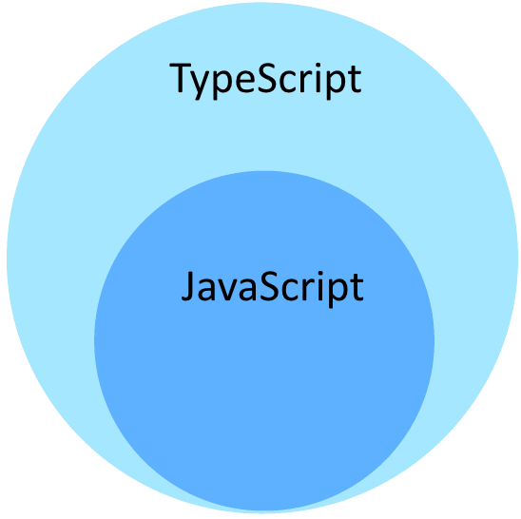

Understanding terms
Front End JavaScript Library
JavaScript Library Manage Application State
ESRI Developed JavaScript library
Optional Static Typing

Slide 27
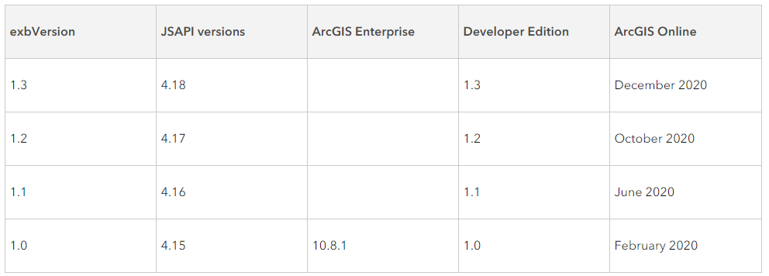
Versions
Web App Builder
Current Version - 2.19
Experience Builder
Current Version 1.3
Version 1.4 to be released any day

Slide 28
Question?
Will Experience Builder replace Web AppBuilder?
ESRI’s Official Answer – There is no plan to replace and make Web AppBuilder obsolete. Both builders will be running and maintained in parallel. Web AppBuilder will continue to be available.
Paul’s Unofficial – Official Answer
YES!!
For many years ESRI said they had no plan to deprecate ArcGIS Desktop (ArcMap) as they were building ArcGIS Pro. They said they would maintain both in parallel. Now they say ArcGIS Desktop(ArcMap) will no longer be supported in 2026. I am not sure on the timeline, but expect something similar here.

Slide 29
Question?
Can anything be transferred between Web AppBuilder and Experience Builder?
ESRI’s Official Answer – You need to re-configure apps or rewrite customer widgets created with Web AppBuilder if you choose to move them to Experience Builder.
Paul’s Unofficial – Official Answer
NO!! - Starting over from scratch
Will Experience Builder reach functional parity of Web AppBuilder?
ESRI’s Official Answer – Starting with the core and popular widgets, Experience builder is planned to reach most of functional parity of Web AppBuilder through incremental releases.
Paul’s Unofficial – Official Answer
Yes – But, we have no idea when

Slide 30
Mobile
Web App Builder = Mobile Friendly
Experience Builder = Mobile First

Slide 31
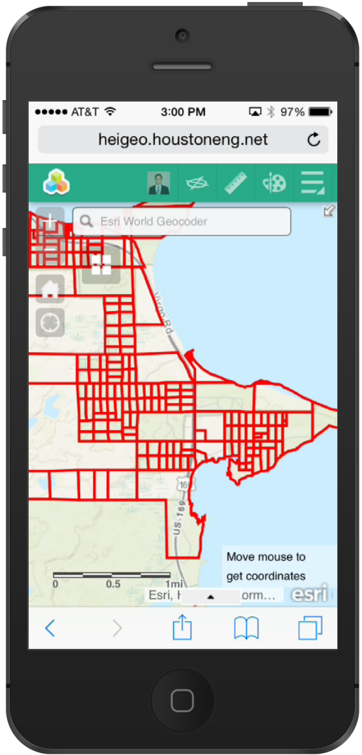
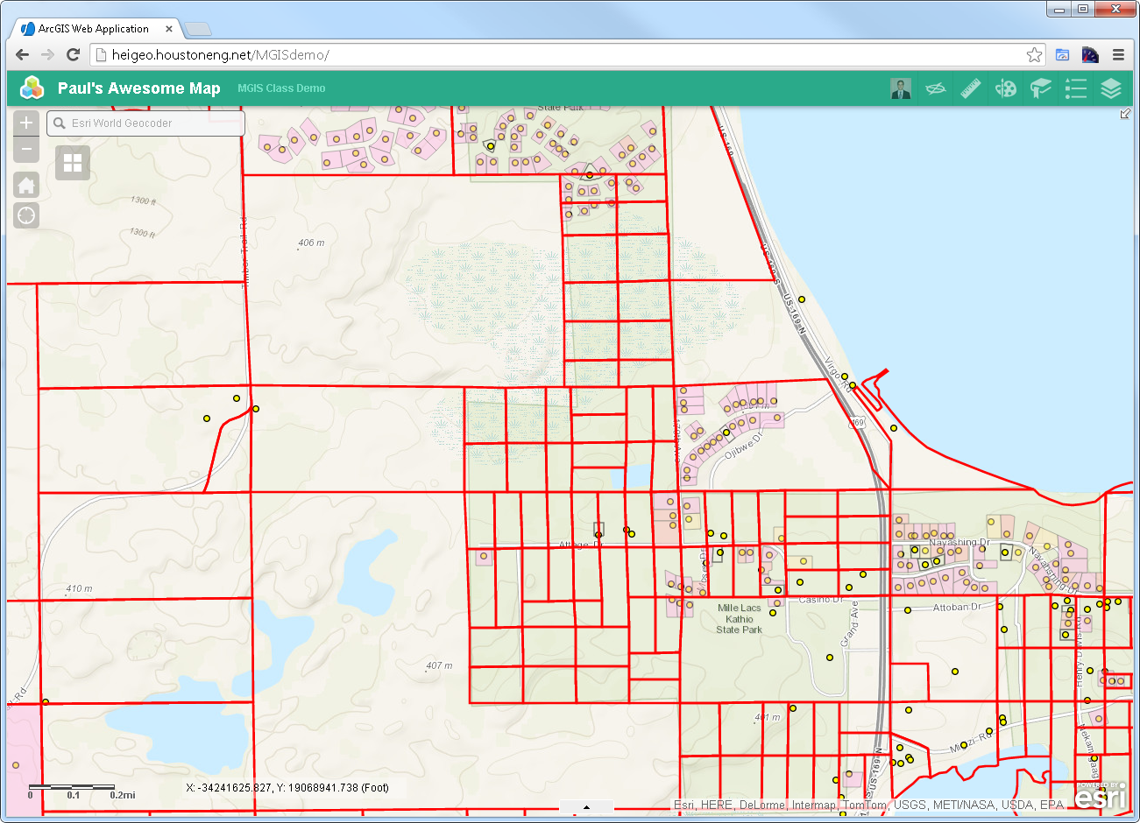
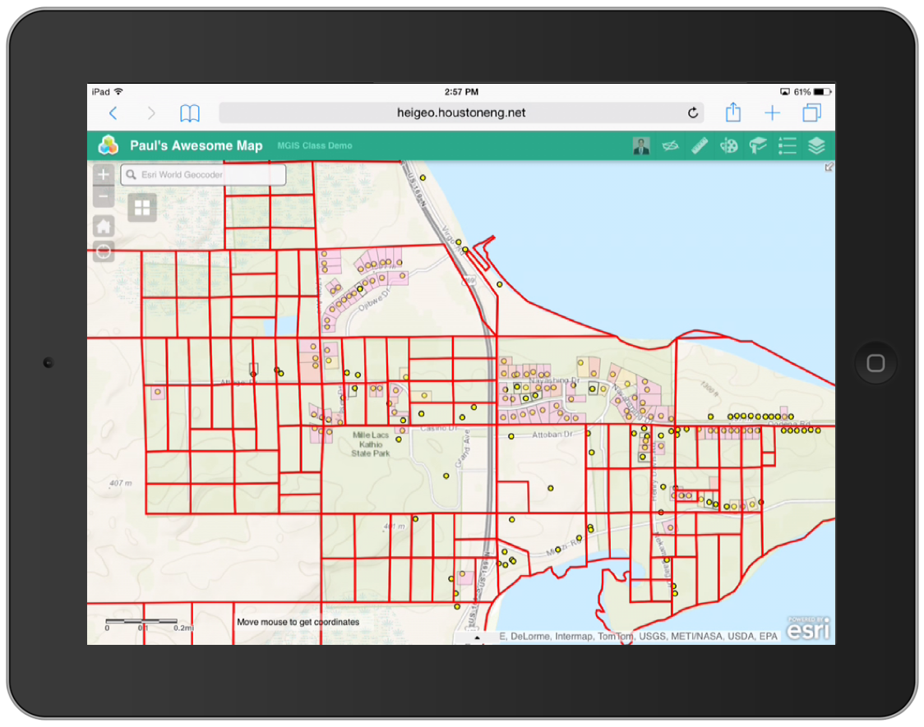
Responsive web design

Slide 32
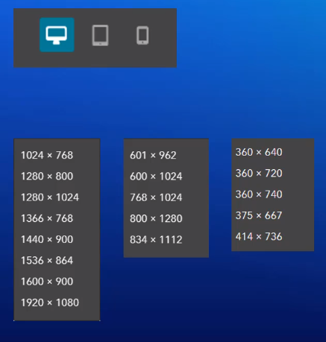
Responsive web design – Experience builder
Three screen modes:
Large
Medium
Small

Slide 33
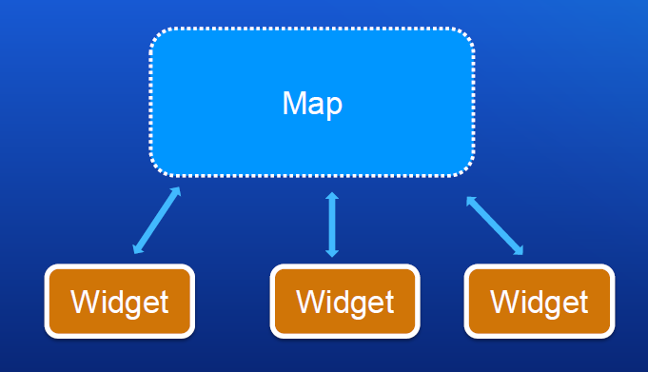
Web AppBuilder – Map centric app

Slide 34
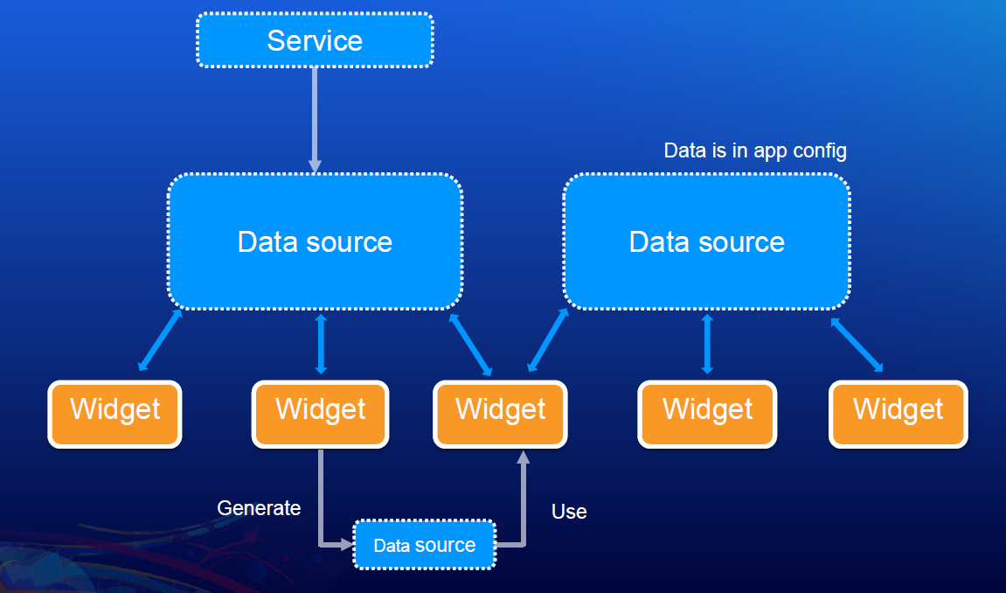
Experience builder – Data source centric app

Slide 35
2021 Experience Builder Widget Road Map
*Query
*Chart
*Coordinate Conversion
*Branch Version Management
Service Explorer
Water Outage Isolation Trace
Print
Elevation Profile
Time Slider
Add Data
Business Analyst
Image Gallery
Search
Edit
Geoprocessing
Sketch (Draw)
Swipe
Basemap Gallery
Directions
Slice (3D)
Line of Sight (3D)
Daylight (3D)
*Planned for next update

Slide 36

Experience builder – Use Case
Is Experience Builder mature enough to use in real world cases?

Slide 37
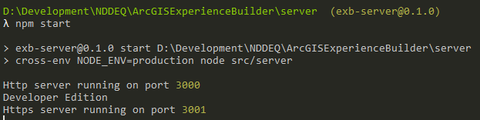
Node.js
What do I need to know about Node.js after initial install?
Command Prompt – Go to “Server” folder
Type “npm start”

Slide 38
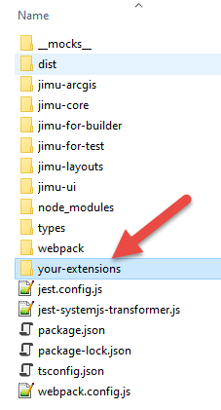
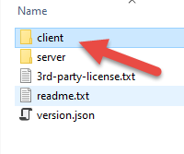

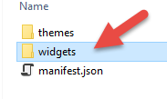
Widget Folder
/client/your-extensions/widgets

Slide 39
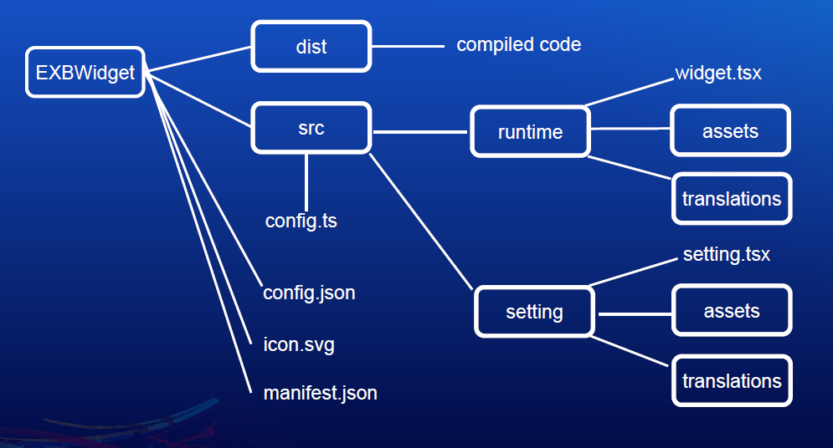
Widget File Structure

Slide 40
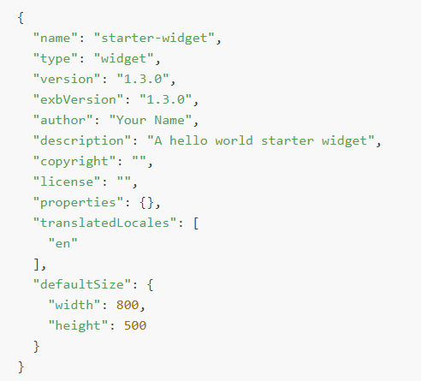
Manifest.json

Slide 41
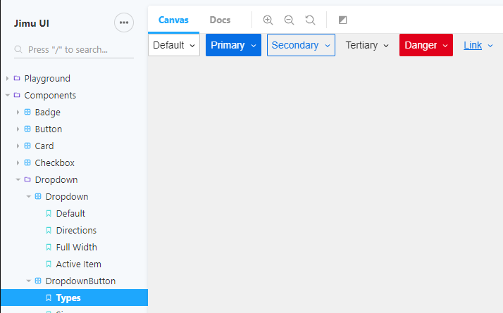
Storybook – UI Components

Slide 42
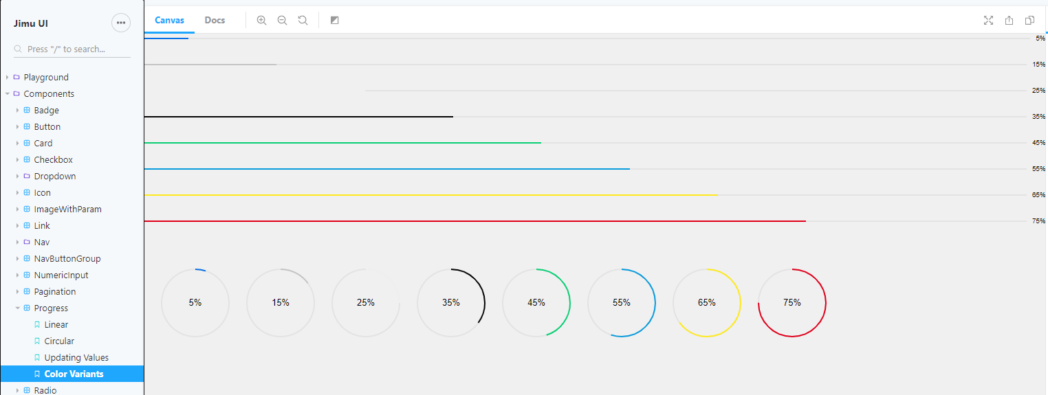
Storybook – UI Components

Slide 43
Developer Edition – First Steps summary
Download Developer Edition Files
Register App ID
Create new “Experience” - Web Map
Build Custom Widget

Slide 44
Examples
https://experience.arcgis.com/experience/dde155a7b903429a90c7fe39e281f9be/page/page_1/
https://experience.arcgis.com/experience/22c7182a162d45788dd52a2362f8ed65
https://experience.arcgis.com/experience/f7f674ce7a4a45b4afc8c3c4b2bdba7d
https://experience.arcgis.com/experience/28466a6d361545358ec64fa3e932ee86/page/page_0/

Slide 45
Helpful Resources
ArcGIS Experience Builder Online Edition
experience.arcgis.com
Download Developer Edition
developers.arcgis.com/experience-builder
Help documentation
doc.arcgis.com
Community
community.esri.com/community/arcgis-experience-builder
UI Components
developers.arcgis.com/experience-builder/storybook
Samples Repo
community.esri.com/t5/arcgis-experience-builder/ct-p/arcgis-experience-builder

Slide 46

Time to code - Exercises
Exercises and slides available here:
github.com/paulhedlund/experiencebuilderGISLIS

